Slide 1
Supersingular
Elliptic Curve
Isogeny
Diffie Hellman Merkel
Key Exchange

Slide 2
Why Should you Care?
Quantum Secure
  Can’t afford to wait till quantum computing is a reality to move over
Short Key length for reasonable security
  For 128 post-quantum security bits (or 194 classical) :
    Public is 48B
    Private is 564B (330B with compression)
  Shortest keys for post quantum security (currently known)
The maths is very cool and Interesting
Provides forward secrecy
In 3rd round of NIST PQC standardisation

Slide 3
Why Shouldn’t you Care?
The difficulty of the problem isn’t as well understood as other (i.e. discrete log problem)
Isn’t nearly as fast as classical algorithms 5 signs/s compared to 10000 signs/s for ECDSA with 256 classical bits of security
Only an Alternate Candidate in NIST PCQ Standardisation Process
Difficult to implement and understand

Slide 4
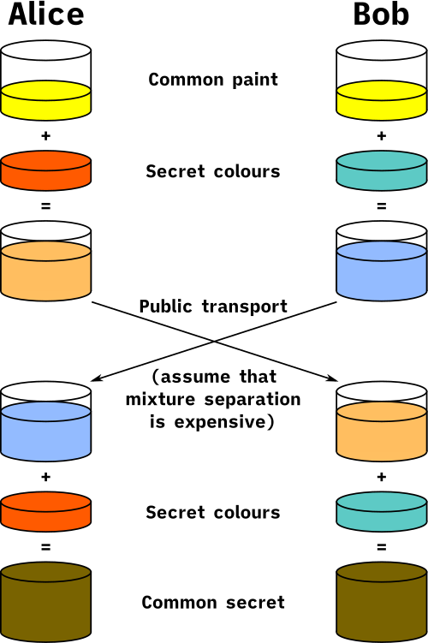
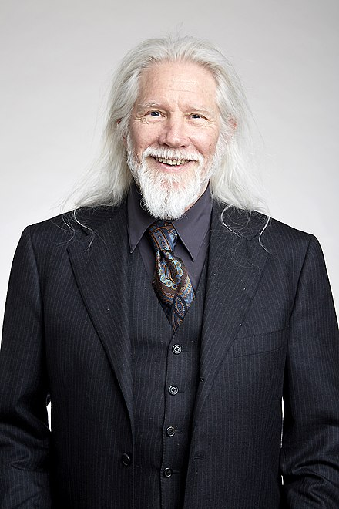

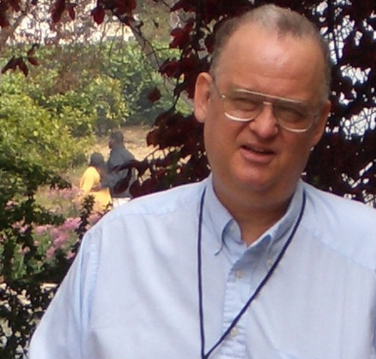
Diffie Hellman Merkle Key Exchange
A key exchanging protocol
This typically works off the difficult of the discrete log problem (not quantum secure)
Whitfield Diffie
Martin Hellman
Ralph Merkle

Slide 5
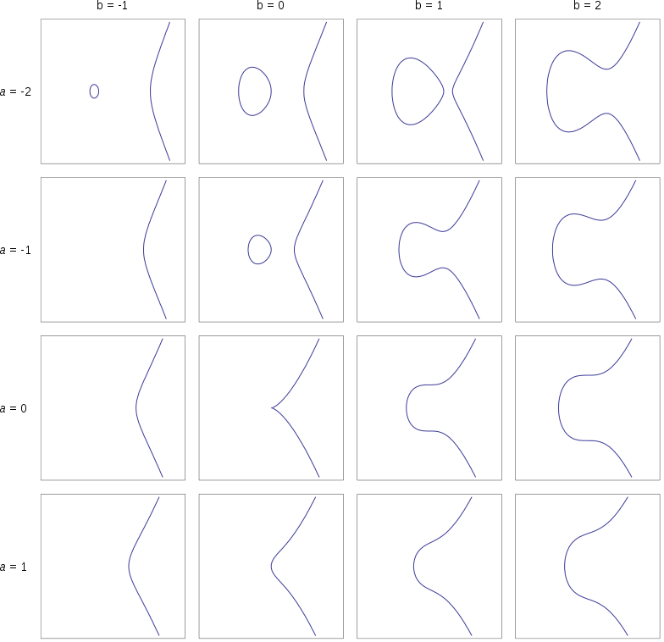
Elliptic Curves
General Form : y² = x³ + ax + b
Other forms used for efficiency but all equivalent to general form
Forms a vector space

Slide 6
Briefly begins the heavy Maths
But now time for quick questions about the previous material

Slide 7
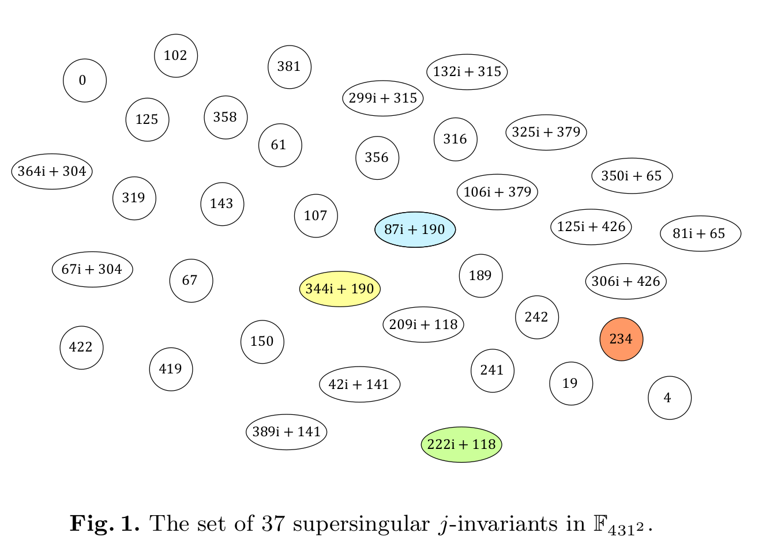
Supersingular J-invariants
For SIDH we work in 𝔽_{p^2} ≅ 𝔽_{p}[i] (Guassian ℤ mod p)
J invariant defines sets of isomorphic EC over 𝔽_{p^2}
(the number of such sets grows linearly with p)

Slide 8
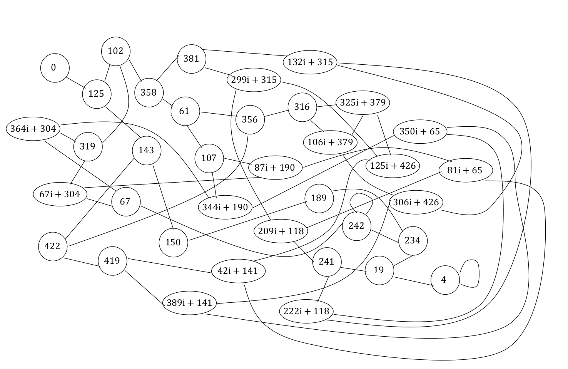
Isogenies
We are interested in separable isogenies
These are in one to one correspondence with finite subgroups of points on the curves
Eg group G gives rise to φ : E → E’ with kernal G
Velu’s Formula gives us a way of calculating these

Slide 9
Overview of Algorithm
Public Parameters :
- wa = 2; wb = 3
- p = 2^(ea) * 3^(eb) – 1; p prime and 2^(ea) ≈ 3^(eb)
- Initial curve E defined over 𝔽p(i)
- Pa, Qa : Points on E st Pa, Qa generate all curves of order 2^b
- Pb, Qb : Points on E st Pb, Qb generate all curves of order 3^b
Public Key Generation : Let c be one generating the key and c’ be the other
- Gen private key k ∈ [0, 2^ec)
- Sc = Pc + k * Pc
- for i ∈(eA – 1, 0]
- Calculate φi = Isogony with kernal <wc ^ I * Sc>
- E, Pc’, Qc’, Sc = φi(E), φi(Pc’), φi(Qc’), φi(Sc)
- Output(Pc’, Qc’, E)
Private Key Generation : Let c be one generating the key and c’ be the other
- Take E’, φ(Pc), φ(Qc) = Output of c’ Public Key Generation
- Sc = φ(Pc) + k * φ(Qc) (Same key as in public Key Generation)
- Move E’ through Isogonies as in Public Key Generation
- Output j(E’)

Slide 10
That’s Great… but where’s the Code?
Great question…
Depends how much time we have left :P

Slide 11
Links
Github : github.com/RiverNewbury/Haskell-SIDH

